Slide 1
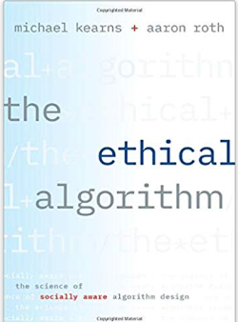

Data Ethics, Concluded
https://tinyurl.com/cis545-lecture-10-25-21
Zachary G. Ives
University of Pennsylvania
CIS 545 – Big Data Analytics

Slide 2
Ethical Principles around Data
Autonomy
The right to control your data, possibly via surrogates
Informed consent
You should explicitly approve use of your data based on understanding
Beneficence
People using your data should do it for your benefit
Non-maleficence
Do no harm

Slide 3
Facebook’s Mood Manipulation Experiment
In 2012 researchers at Facebook and Cornell University manipulated the newsfeed of selected Facebook users.
Some users were shown more positive articles.
Others were shown more negative or sad articles.
People who were shown more positive articles, posted more positive articles themselves on Facebook
People who were shown shown more negative articles, posted more negative articles.
i.e., they demonstrated “emotional contagion”
Proc. of the National Academies of Science (2014): “Experimental Evidence of Massive-Scale Emotional Contagion Through Social Networks”

Slide 4
Data Science and Informed Consent
Informed consent is often buried in the fine print
Data is often collected first; the experiment comes later
How the data, once collected, is going to be used is difficult to control
Most people ignore the terms of usage and just click through!

Slide 5
Intellectual Property
Patents only protect implementations, not ideas
Artistic expression can be copyrighted:
exclusive legal right to print, publish, perform, film or record and authorize others to do the same
Derivative work can be created with permission
There’s also a notion of citation, in which we give credit to the owner
And many open-source licenses establishing terms
What about data?
Wikipedia, Yelp, Rotten Tomatoes, TripAdvisor
A clinical data set, a company’s data, your gene sequence, …

Slide 6
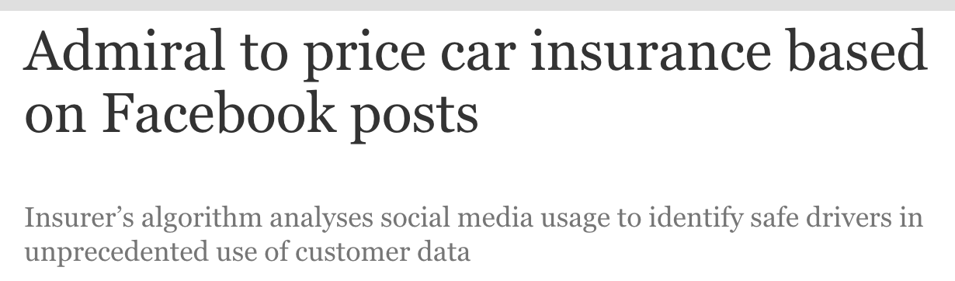


Slide 7


Privacy
https://www.panmacmillan.com/blogs/literary/george-orwell-quotes-1984-animal-farm
Notes:
Privacy is a basic human need
Privacy is not black and white – it is an exercise of control
Loss of privacy occurs when there’s a loss of control over personal data

Slide 8
OKCupid Data Publicly Released
WIRED, Michael Zimmer 5/14/16
May 8, 2016: Danish researchers publicly released a dataset of ~70,000 OKcupid users
usernames, age, gender, location, what kind of relationship they’re interested in
personality traits, answers to 1000s of profiling questions
Did they attempt to anonymize?
Researchers’ response: “… all the data found in the dataset are or were already publicly available, so releasing this dataset merely presents it in a more useful form.”
Notes:
OKCupid Study Reveals the Perils of Big-Data Science

Slide 9
Was the OKCupid Data “Public”?
Data acquired by screen scraping – methodology not fully explained
Likely from an OkCupid profile researchers created!
OkCupid users may restrict the visibility of their profiles to logged-in users only
Likely that the researchers collected—and released—profiles that were intended to not be publicly viewable

Slide 10
Privacy is not Simple
Many rules governing use of collected information
HIPAA: Health Insurance Portability and Accountability Act
FERPA: Family Educational Rights and Privacy Act
GDPR General Data Protection Regulation (Europe)
However, “information leakage” can lead to unexpected disclosures
e.g. smart water meters
“Privacy by trust” versus “privacy by design”
Notes:
https://takebackyourpower.net/comprehensive-report-how-smart-meters-invade-privacy/

Slide 11
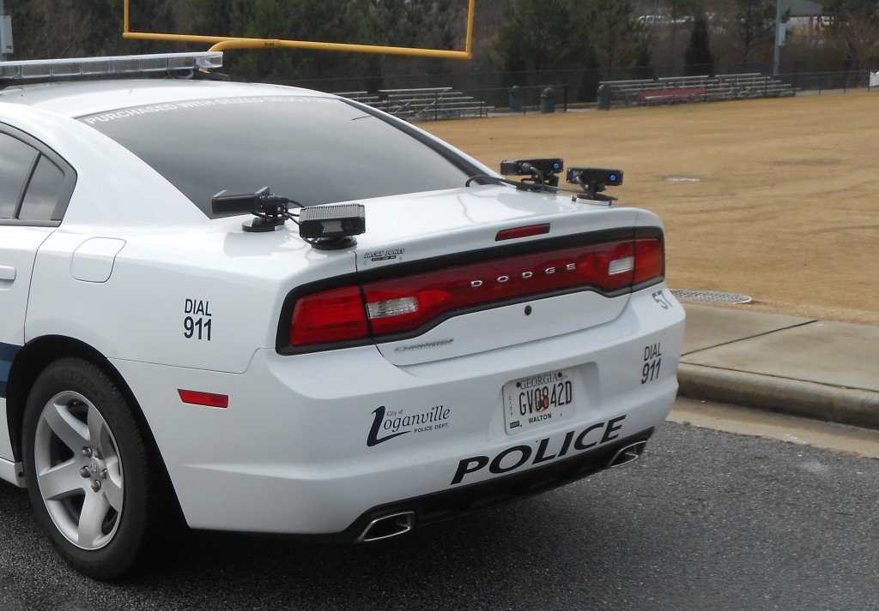

Another Example: License Plate Readers

Slide 12
Can We Make Data Private? Correlating “De-identified” Data
Netflix Prize Competition: released a de-identified data set with user ID, date, movie name, and the rating given by the user for that movie.
Researchers were able to link users with IMDb's system where the users were identified, and talked about (some of) the movies they watched.
Problem: “Sparsity” of participation makes it easy to match
In Netflix data, no two profiles are more than 50% similar.
If a Netflix profile is more than 50% similar to a profile in IMDB, then there is a high probability that the two profiles are of the same person
A. Narayanan and V. Shmatikov, “Robust de-anonymization of large sparse datasets …,” Proc. 29th IEEE Symp. Security and Privacy, 2008.

Slide 13
Differential Privacy
When do you feel safe releasing personal information?
My answers have no impact on the privatized released result?
With high probability, an attacker looking at the privatized released result cannot learn any new information about me?
These are not achievable.
Differential privacy maximizes accuracy of queries over statistical databases while minimizing the chances of identifying its records
it adds noise and provides guarantees against a “privacy budget”.
The privatized released result is nearly the same whether or not I submit my information.
Dwork and Roth, “Algorithmic Foundations of Differential Privacy,” Foundations and Trends in Theoretical Computer Science (2014).
Notes:
https://t.reembed.com/0dFVes16AKq43QanOK3hDBwC

Slide 14
Ethics Surrounding Algorithms (i.e., around Machine Learning)

Slide 15



Algorithms are not neutral
Algorithms encode our biases when:
Training data set isn’t representative
Past population is not representative of the future population
Overfitting to underrepresented data is common

Slide 16

The Verge,
https://www.theverge.com/2018/7/26/17615634/ amazon-rekognition-aclu-mug-shot-congress- facial-recognition

Slide 17
Fairness
Fairness has been studied in social choice theory, game theory, economics and law.
Currently trendy in theoretical computer science
Discrimination of an individual: An individual from the target group gets treated differently from an otherwise identical individual not from the target group.
Discrimination in aggregate outcome: the percentage success of the target group compared to that of the general population.
Dwork, Hardt, Pitassi, Reingold and Zemel,
“Fairness through Awareness”
Proc. 3rd Innovations in Theoretical Computer Science, 2012.

Slide 18
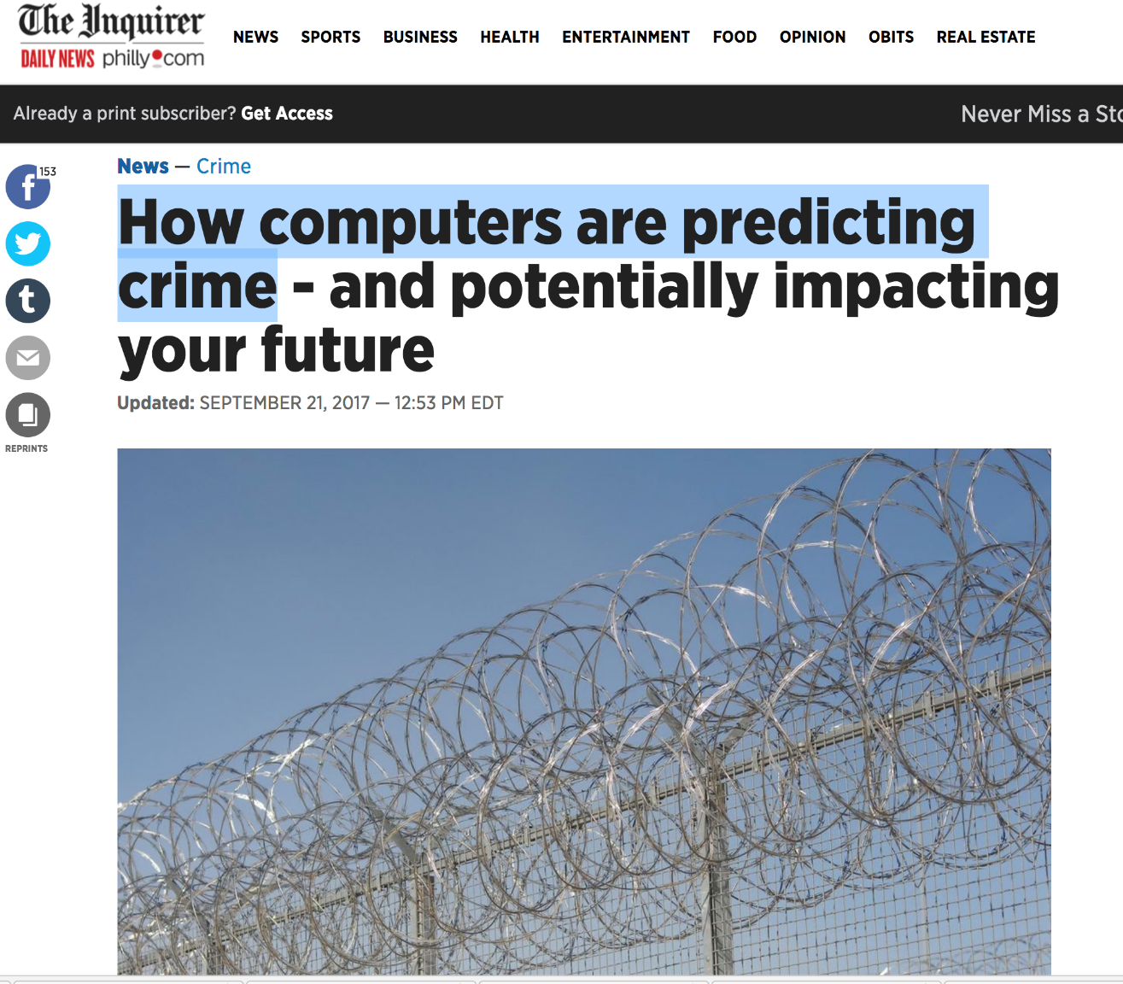
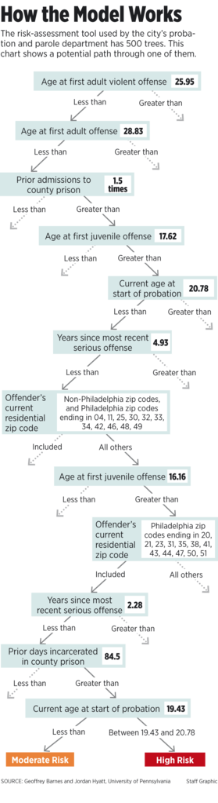
Notes:
Predict probability of re-arrest using a random forest

Slide 19
Brief Review
https://canvas.upenn.edu/courses/1606906/quizzes/2741522
"De-identified" data, if not protected by differential privacy:
Can safely be shared without revealing private information
Can be correlated with other data to reveal information
Is sparse
Is too large to share
Algorithms aren't neutral, in significant part because:
It is not profitable to be fair
Datasets are too large to handle
No trends can be spotted in a population
The training data may not adequately represent the population

Slide 20
Ethics summary
Codes of conduct for research are fairly well understood
Get IRB approval
obtain informed consent
protect the privacy of subjects
maintain the confidentiality of data collected, minimize harm
Fairness is more subtle
What is fair treatment of a group: equal accuracy? FP rate?
Key technical aspects:
differential privacy (bounds amount of information revealed)
trade-off between optimizing outcomes vs avoiding discrimination against a group

Slide 21
Machine Learning Intro and Unsupervised Learning Overview
Zachary G. Ives
University of Pennsylvania
CIS 545 – Big Data Analytics

Slide 22

Data Is Hopefully Not Random!
There must be correlations and structure in our data values, and between them and classes or outcomes – otherwise we just have random phenomena!
For the next part of this class: we need to find that structure, aka the underlying model!
https://commons.wikimedia.org/wiki/File:Slot_machine.jpg
CC-SA 2.0

Slide 23
Machine Learning Basics
Data is typically comprised of features – values that might be useful in predicting the output
Red, green, blue values of pixels in an image
Keywords in a document
Purchases of a customer
These are used in machine learning, and as we saw they are in a matrix!
“Not all features are created equal”
Some are easier to learn from
Some are correlated with others!

Slide 24
Two Flavors of Machine Learning
1. Find the structure within the data (unsupervised)
2. Find a function mapping from data features to classes (supervised)
x
x
x
x
x
x
Input data: x₁, x₂, x₃, …, x_{n}
x
x
x
x
x
x
x
x
x
Input data: x₁, x₂, x₃, …, x_{n}
x
o
x
x
o
+ Labels: y₁, y₂, y₃, …, y_{n}
o
x
x
o
o

Slide 25
A Workflow for ML: Unsupervised → Supervised Learning
Sometimes data has MANY fields/features, each of which might be a good feature
But which features actually matter the most?
Are they in the right representation?
Often, we start with unsupervised learning, which can:
Reduce number of dimensions, generate more “natural” features
Provide insights into “natural clusters”
Then we’ll run supervised learning methods (see later modules)!

Slide 26
Recall the Inputs to ML Problems
Data will generally be in matrices – either integer or floating-point
0 | 1 | 2 | 3 | 4 | 5
instance
feature
Each row is typically a single observation
If we have non-numeric data we may need to transform or one-hot encode it

Slide 27
Sparsity
Sometimes (especially with one-hot encoding) we cause an explosion of columns for each item!
For efficiency we may want to use a sparse matrix data structure to hold the matrix…
Alabama | Alaska | … | Wyoming
0 | 0 | … | 1
1 | 0 | … | 0

Slide 28
Conceptual Storage of a Normal Matrix vs a Sparse Matrix
[
[ 0, 1, 0, 0, 0, …], [ 1, 0, 0, 0, 0, …], …]
{(0, 1) → 1, (1, 0) -> 1, …}
By default, we essentially have a list of lists of ints – one int per cell
A sparse matrix stores a map from cell coordinates to nonzero items (this is one of several forms)
numpy array() or ndarray()
scipy.sparse.csr_matrix(array)
Notes:
The todense() function will go back from a CSR Matrix to a regular array

Slide 29
Brief Review
https://canvas.upenn.edu/courses/1606906/quizzes/2688466
Unsupervised machine learning
Predicts class membership
Requires TensorFlow
Finds structure in the values of the features
Develops machine learning models without needing human input
To store values, a sparse matrix uses
a list of arrays
an array of arrays
an array of lists
a dictionary

Slide 30
This Module: Finding Structure in Our Matrix
We’ll start our discussion off by looking at how to reduce the number of features – dimensionality reduction
Principal Components Analysis (PCA)
Scaling PCA to big data
PCA alternatives

Slide 31
Principal Components Analysis
https://tinyurl.com/cis545-011
Zachary G. Ives
University of Pennsylvania
CIS 545 – Big Data Analytics

Slide 32
Unsupervised Machine Learning
Technique 1: Dimensionality Reduction
Principal Component Analysis (PCA)
Reduce high number of correlated features to a lower number of uncorrelated features
New features are weighted combinations of originals
t-Distributed Stochastic Neighbor Embedding (t-SNE)
Technique 2: Clustering
Find groupings in the data

Slide 33
What Is Principal Component Analysis?
An unsupervised method that takes X from p dimensions down to k dimensions
Each dimension is orthogonal to the rest
Why is this helpful?
Reduces noise in the data for supervised learning
Reduces data
Simpler to visualize data (though dimensions may be unintuitive!)

Slide 34
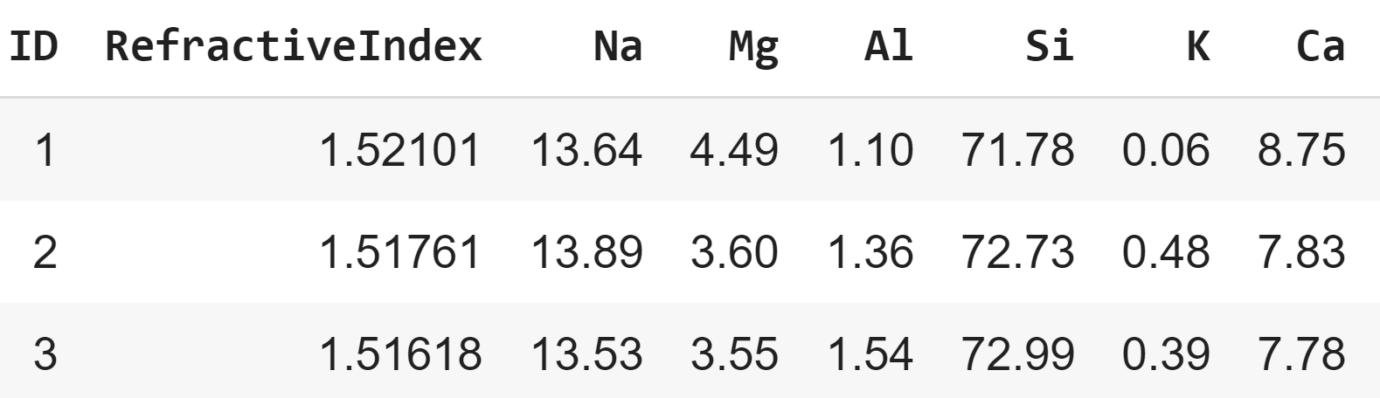
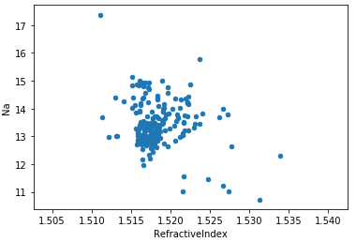
The Intuition
Take a data set as a matrix X of features
Some have little variance, some have a lot
Some are correlated, some are not
Scale each dimension so they are comparable
Consider the glass dataset, with 2D to the right
Sodium and refractive index might in fact be correlated!
Find the vector that maximizes variance – the principal eigenvector
Repeat for the next orthogonal vector, etc.

Slide 35
How Do We Formalize This?
Consider the ath feature X^{(a)}, then we can compute the variance (std deviation squared) of this feature :
$${var\left(X^{\left(a\right)}\right)=(s^{(a)})}^{2}=\frac{\sum_{i=1}^{n}{{\left(X_{i}^{(a)}−\overline{X^{(a)}}\right)}^{2}}}{(n−1)}$$
and we can generalize for 1 <= a <= p to get a variance matrix
Similarly, we can define covariance to capture how the dimensions vary from the mean with respect to each other
$$cov\left(X^{\left(a\right)},X^{\left(b\right)}\right)=\frac{\sum_{i=1}^{n}{(X_{i}^{\left(a\right)}−\overline{X^{\left(a\right)}})(X_{i}^{\left(b\right)}−\overline{X^{\left(b\right)}})}}{n−1}≈E[\left(X^{\left(a\right)}−\overline{X^{\left(a\right)}}\right)\left(X^{\left(b\right)}−\overline{X^{\left(b\right)}}\right)]$$

Slide 36
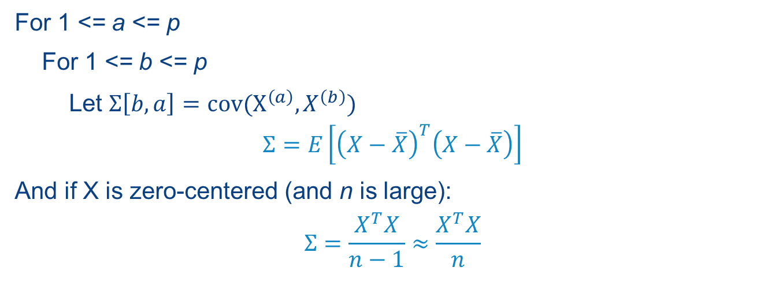
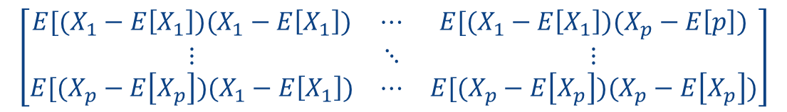
The Covariance Matrix
$$\left[\begin{matrix}E[(X_{1}−E\left[X_{1}\right])(X_{1}−E\left[X_{1}\right]) & ⋯ & E[(X_{1}−E\left[X_{1}\right])(X_{p}−E\left[p\right]) \\ ⋮ & ⋱ & ⋮ \\ E[(X_{p}−E\left[X_{p}\right])(X_{1}−E\left[X_{1}\right]) & ⋯ & E[(X_{p}−E\left[X_{p}\right])(X_{p}−E\left[X_{p}\right])\end{matrix}\right]$$
For 1 <= a <= p
For 1 <= b <= p
Let $Σ\left[b,a\right]=cov(X^{\left(a\right)},X^{\left(b\right)})$
$$Σ=E\left[{\left(X−\overline{X}\right)}^{T}\left(X−\overline{X}\right)\right]$$
And if X is zero-centered (and n is large):
$$Σ=\frac{X^{T}X}{n−1}≈\frac{X^{T}X}{n}$$
Notes:
The diagonal is in fact the variances for each attribute

Slide 37
From Covariance Matrix, Computing the Principal Components
Compute the eigenvectors and eigenvalues for the covariance matrix
(Can also perform Singular Value Decomposition)
Sort the eigenvectors from highest to lowest, pick the top $k≤p$
These are our new, highest-information dimensions – each will be orthogonal
Construct a projection matrix W from these k eigenvectors
Transform original dataset X by multiplying W to obtain a k-dimensional feature subspace Y
$$Y_{n×k}=X_{n×p}⋅W_{p×k}$$

Slide 38
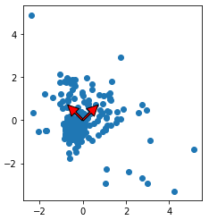
PCA, Visualized
Transform to new coordinate system:
Find directions of maximum variation (covariance)
Minimize reconstruction error
PC1
PC2

Slide 39
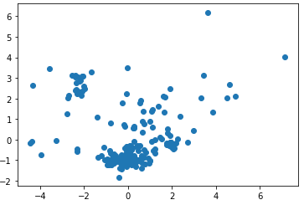
PCA Projection
PC2
PC1
Notes:
Plot using the new coordinate system.

Slide 40
Observations
PCA is not scale-invariant as it finds the direction of maximum variation!
We can look at explained variance for each component – the ratio of the principal component vs the total variance across all components
First k principal components explain the most variance any k variables can explain

Slide 41
Brief Review
https://canvas.upenn.edu/courses/1606906/quizzes/2688519
The first component in PCA is based on the vector that
minimizes variance
minimizes entropy
maximizes variance
is orthogonal to the original features
(If we are not using SVD), PCA uses the eigenvectors and eigenvalues of
the weight transfer matrix
the weight matrix
the covariance matrix
the variance matrix

Slide 42
PCA Recap
Finds the directions of maximum variation
by computing the principal eigenvectors of the covariance matrix
Returns a projection matrix and a feature subspace that minimizes reconstruction error!
Next: how do we use this?

Slide 43
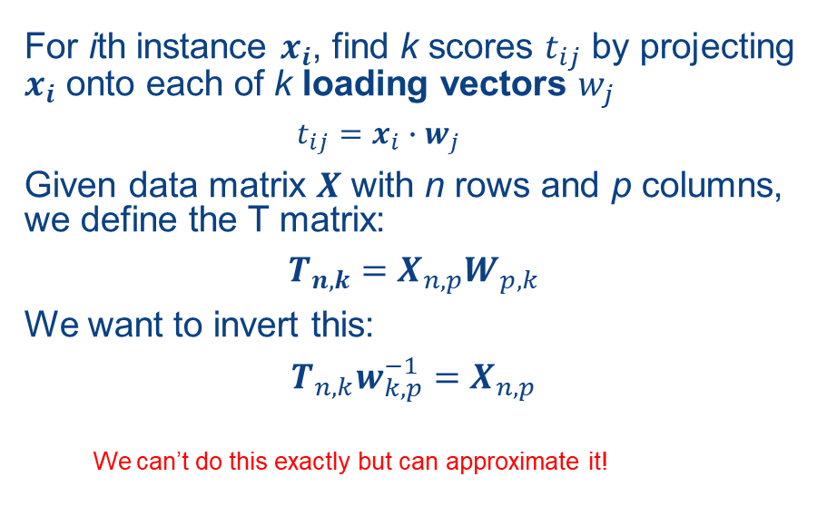
Formalizing PCA
For ith instance $x_{i}$, find k scores $t_{ij}$ by projecting $x_{i}$ onto each of k loading vectors $w_{j}$
$$t_{ij}=x_{i}∙w_{j}$$
Given data matrix $X$ with n rows and p columns, we define the T matrix:
$$T_{n,k}=X_{n,p}W_{p,k}$$
We want to invert this:
$$T_{n,k}w_{k,p}^{−1}=X_{n,p}$$
We can’t do this exactly but can approximate it!

Slide 44
Applying PCA
Zachary G. Ives
University of Pennsylvania
CIS 545 – Big Data Analytics

Slide 45
A PCA Example
Glass Identification Data Set from UC Irvine ML Repository
https://archive.ics.uci.edu/ml/datasets/glass+identification
The task:
Forensic scientists need to identify the type of glass based on its chemical composition!
Can we take a dataset of glass instances and their chemical compositions and:
Reduce dimensionality (by default 8 elements + refractive index are given)
Predict the type of glass: building, vehicle, container, tableware, headlight [this part uses supervised machine learning]

Slide 46
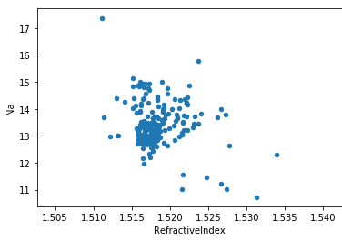
Glass Data in a DataFrame
 | ID | Refractive Index | Na | Mg | Al | Si | K | Ca | Ba | Fe | Type
0 | 1 | 1.52101 | 13.64 | 4.49 | 1.10 | 71.78 | 0.06 | 8.75 | 0.00 | 0.0 | 1
1 | 2 | 1.51761 | 13.89 | 3.60 | 1.36 | 72.73 | 0.48 | 7.83 | 0.00 | 0.0 | 1
2 | 3 | 1.51618 | 13.53 | 3.55 | 1.54 | 72.99 | 0.39 | 7.78 | 0.00 | 0.0 | 1
3 | 4 | 1.51766 | 13.21 | 3.69 | 1.29 | 72.61 | 0.57 | 8.22 | 0.00 | 0.0 | 1
4 | 5 | 1.51742 | 13.27 | 3.62 | 1.24 | 73.08 | 0.55 | 8.07 | 0.00 | 0.0 | 1
... | ... | ... | ... | ... | ... | ... | ... | ... | ... | ... | ...
# Remove the ID and the Type labels for # the training data set X
X = glass_df.drop(['ID','Type'], axis=1)
# Labels are in a separate y vector
y = glass_df['Type']

Slide 47
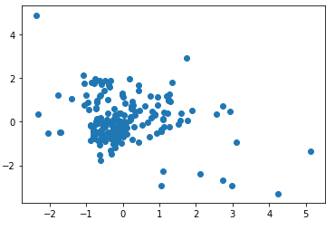
Best Practice: Scaling and Centering
# Standardize features by removing the mean and scaling to unit variance
from sklearn.preprocessing import StandardScaler
# Standardizing the features between 0 and 1
X = StandardScaler().fit_transform(X)
X
array([[ 0.87286765, 0.28495326, 1.25463857, ..., -0.14576634, -0.35287683, -0.5864509 ], [-0.24933347, 0.59181718, 0.63616803, ..., -0.79373376, -0.35287683, -0.5864509 ], [-0.72131806, 0.14993314, 0.60142249, ..., -0.82894938, -0.35287683, -0.5864509 ], ..., [ 0.75404635, 1.16872135, -1.86551055, ..., -0.36410319, 2.95320036, -0.5864509 ], [-0.61239854, 1.19327046, -1.86551055, ..., -0.33593069, 2.81208731, -0.5864509 ], [-0.41436305, 1.00915211, -1.86551055, ..., -0.23732695, 3.01367739, -0.5864509 ]])

Slide 48
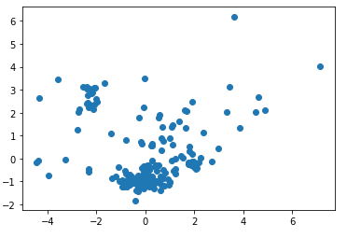
PCA in SciKit-Learn
from sklearn.decomposition import PCA
pca = PCA(n_components=9)
X2 = pca.fit_transform(X)
# Let's see the components
pca.components_
array([[ 0.54517662, -0.2581256 , 0.11088095, -0.42870863, -0.22883635, -0.21934405, 0.49230609, -0.25037512, 0.18584154], [ 0.28568318, 0.27035007, -0.59355826, 0.29521154, -0.15509891, -0.15397013, 0.3453798 , 0.48470218, -0.06203879], [ 0.08691083, -0.38491962, 0.00841796, 0.32923712, -0.45870884, 0.66257412, -0.00098473, 0.07405473, 0.28445055], [ 0.14738099, 0.49124204, 0.37878577, -0.13750592, -0.65253771, -0.03853544, -0.27644322, 0.13317545, -0.23049202], [-0.0735427 , 0.1536833 , 0.12350912, 0.01410888, 0.00850012, -0.30703984, -0.18818774, 0.25133426, 0.87326405], [ 0.11528772, -0.55811757, 0.30818598, -0.01885731, 0.08609797, -0.24363237, -0.14866937, 0.65721884, -0.24304431], [ 0.08186724, 0.14858006, -0.20604537, -0.69923557, 0.21606658, 0.50412141, -0.09913463, 0.35178255, 0.07372136], [-0.7522159 , -0.12769315, -0.07689061, -0.27444105, -0.37992298, -0.10981168, 0.39870468, 0.14493235, -0.01627141], [ 0.02573194, -0.31193718, -0.57727335, -0.19222686, -0.29807321, -0.26050863, -0.57932321, -0.1982282 , -0.01466944]])

Slide 49
Computing PCA via Singular Value Decomposition
A great tutorial: https://arxiv.org/pdf/1404.1100.pdf
Subtract off the mean from each column
Calculate the SVD of the matrix
Take the k principal eigenvectors for the matrix W

Slide 50
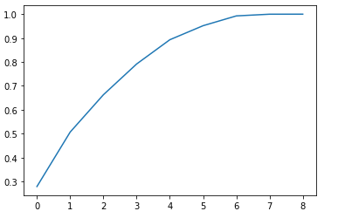
Principal Components vs Variance (Showing with 9 possible components)
np.set_printoptions(suppress=True)
pca.explained_variance_ratio_
array([0.27901819, 0.2277858 , 0.15609378, 0.12865138, 0.10155581, 0.05862613, 0.04099538, 0.00709477, 0.00017876])
We should ideally set k
to the smallest value where we see things flatten out

Slide 51
PCA Often Feeds into Supervised Machine Learning
from sklearn import linear_model
from sklearn.metrics import mean_squared_error, r2_score
from sklearn.model_selection import train_test_split
# Split 80% of data to train the supervised classifer
# and 20% to test on
X_train, X_test, y_train, y_test = train_test_split(\
X, y, test_size=0.20, random_state=42)
# Fit the PCA on the training data
pca = PCA(n_components=6)
X_train_2 = pca.fit_transform(X_train)
# Train a simple linearclassifier (details # aren’t important yet) -- tries to find the best # weighted linear combination to match the output)
regr = linear_model.LinearRegression()
regr.fit(X_train_2, y_train)
X_test_2 = pca.transform(X_test)
regr.predict(X_test_2)
regr.score(X_test_2, y_test)
0.8739872270917841

Slide 52
Brief Review
https://canvas.upenn.edu/courses/1606906/quizzes/2688428
Before applying the SciKit-Learn PCA algorithm, it is a good idea to run fit_transform from the
StandardScaler
LinearRegression module
machine learning classifier
Pipeline
To pick the number of dimensions, we look at the
explained variance ratio
KL divergence
average value
dimensionality reduction constant

Slide 53
PCA So Far
We’ve seen that:
We can easily do it via SciKit-Learn over local matrices
We should scale and center
We can pick the number of components via the explained variance ratio
What about if we have truly big data?

Slide 54
Scaling PCA to Big Data
Zachary G. Ives
University of Pennsylvania
CIS 545 – Big Data Analytics

Slide 55
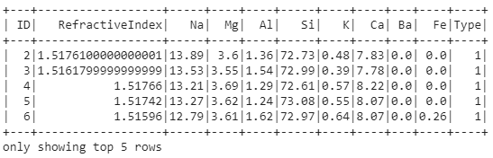
Loading Big Data into Spark
[DenseVector([-2.2414, -13.0845, 41.5609, -45.2941, 13.1599, -2.874]), DenseVector([-2.2496, -13.0844, 41.9784, -45.3113, 12.9424, -2.735]), DenseVector([-2.4224, -12.4907, 41.8856, -44.9697, 12.9633, -2.9404]), …
# ID,RefractiveIndex,Na,Mg,Al,Si,K,Ca,Ba,Fe,Type
schema = StructType([
StructField("ID", IntegerType(), True),
StructField("RefractiveIndex", DoubleType(), True),
…
StructField("Type", IntegerType(), True),
])
glass_sdf = spark.createDataFrame(\
pd.read_csv(
'https://archive.ics.uci.edu/ml/machine-learning-databases/glass/glass.data'), \
schema=schema)

Slide 56
PCA for Big Data: Converting to a Matrix & PCA
from pyspark.mllib.linalg import Vectors
from pyspark.mllib.linalg.distributed import RowMatrix
# Each SDF row gets processed as a list of values
# and converted into a Vector M = RowMatrix(glass_sdf.select('RefractiveIndex','Na’,\ 'Mg','Al','Si','K','Ca','Ba','Fe').rdd.map(\
lambda row: Vectors.dense(list(row.asDict().values()))))
pc = M.computePrincipalComponents(6)
projected = M.multiply(pc)
projected.rows.collect()
[DenseVector([-2.2414, -13.0845, 41.5609, -45.2941, 13.1599, -2.874]), DenseVector([-2.2496, -13.0844, 41.9784, -45.3113, 12.9424, -2.735]), DenseVector([-2.4224, -12.4907, 41.8856, -44.9697, 12.9633, -2.9404]), …

Slide 57
Brief Review
https://canvas.upenn.edu/courses/1606906/quizzes/2688506
For machine learning matrices in Spark, do we need to consider which rows are on which machine?
it depends on the classifier
it depends on the values
yes
no

Slide 58
Summary: Principal Component Analysis
Unsupervised method to reduce dimensionality, often before running supervised machine learning
Finds directions of maximum variance in high-dimensional data
Projects onto a smaller (or equal) subspace
Uses SVD (or eigenvectors) under the covers
Assumes linearity
Sensitive to data scaling

Slide 59
Dimensionality Reduction for Visualization
Zachary G. Ives
University of Pennsylvania
CIS 545 – Big Data Analytics

Slide 60
A Common Alternative for Visualization: t-SNE t-Distributed Stochastic Neighbor Embedding
For visualizing high-dimensional data
Makes similar data points close, maintains “neighbor” relationships
Converts similarities between data points to joint probabilities
Minimizes Kullback-Leibler divergence between joint probabilities of low-dimensional embedding and high-dimensional data
Non-convex cost function
Different initializations yield different results
Can be slow, may want to do PCA first!

Slide 61
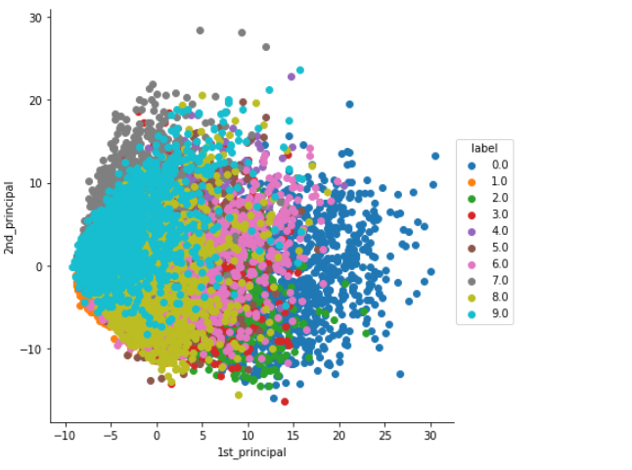
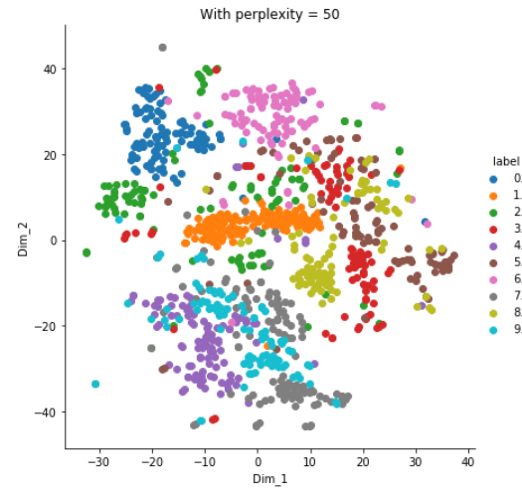
t-SNE vs PCA
https://medium.com/analytics-vidhya/pca-vs-t-sne-17bcd882bf3d
For numeric digit detection (MNIST), visualizations of 1st 2 components
t-SNE
PCA

Slide 62
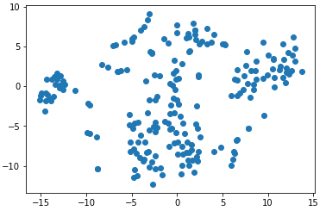
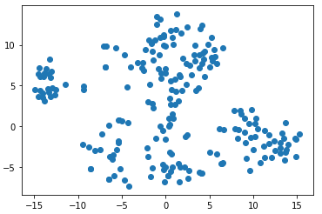
t-SNE in Python
from sklearn.manifold import TSNE
X_embedded = TSNE(n_components=2).fit_transform(X)
plt.scatter(X_embedded[:,0],X_embedded[:,1])
2nd run is different!

Slide 63
Brief Review
https://canvas.upenn.edu/courses/1606906/quizzes/2688448
Which algorithm focuses on preserving neighbor relationships?
t-SNE
SVD
PIK
PCA

Slide 64
Dimensionality Reduction Wrap-up
Two main methods for reducing dimensionality
PCA – assumes linearity, sensitive to scaling, but broadly effective
t-SNE – helpful in visualizing highly dimensional data, doesn’t scale as well
Generally these are used as an intermediate step towards some broader task, whether visualizing + understanding data or doing supervised machine learning

